Slide 1


NETFLIX DATA ANALYSIS PROJECT USING PYTHON
Understanding Global Streaming Patterns through Data
BY-PARTH

Slide 2

INTRODUCTION ABOUT THIS PROJECT
Understanding the Basics
Netflix is one of the largest streaming platforms globally.
The dataset contains details about movies and TV shows available on Netflix.
Goal: Analyze patterns, trends, and insights about Netflix’s content library.

Slide 3

OBJECTIVES
Clean and preprocess Netflix dataset
Explore data using visualizations
Identify top genres, countries, and release trends
Derive meaningful insights to understand Netflix’s content strategy

Slide 4

TOOLS & LIBRARIES
Pandas – Data handling
NumPy – Numerical operations
Matplotlib & Seaborn – Visualization
Plotly – Interactive charts

Slide 5

DATA ANALYSIS OVERVIEW
Focused on :
Movie vs TV Show distribution
Country-wise content
Genre popularity
Ratings and durations
Release trends over time

Slide 6
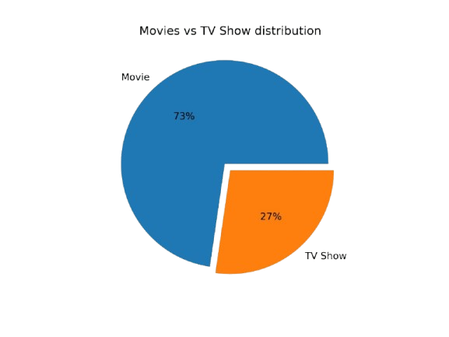




MOVIES VS TV SHOWS DISTRIBUTION
Movies
Observation:
Movies dominate Netflix’s catalog (~73%).
TV shows form around 27%
Insight:
Netflix’s main focus remains on film content but TV content is growing.
Tv Shows

Slide 7
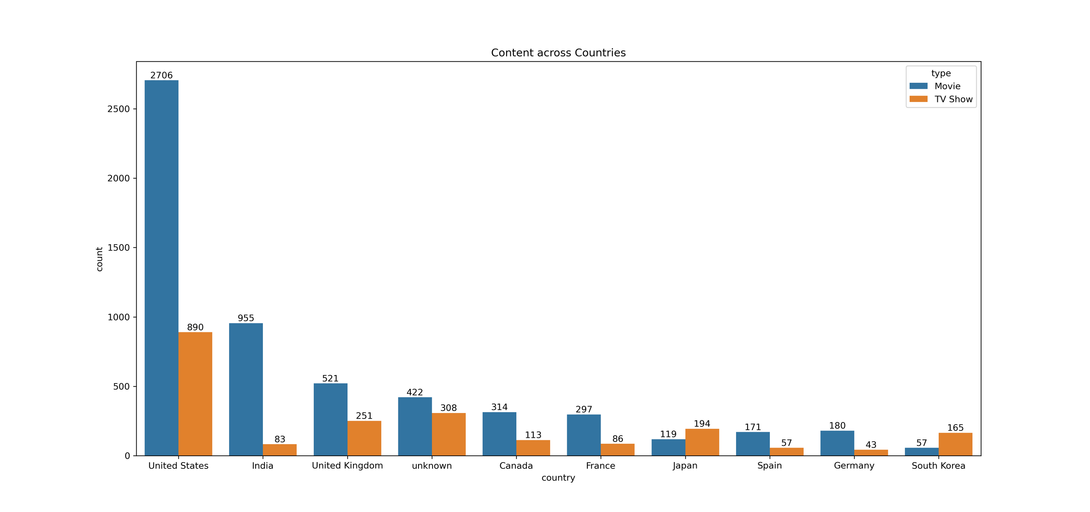
COUNTRY-WISE CONTENT DISTRIBUTION
This bar chart visualizes how Movies and TV Shows are distributed across different countries
Top 3 Content Producing Countries:
United States
India
United Kingdom
Insight: Netflix content is globally diverse, but heavily dominated by USA and India.

Slide 8
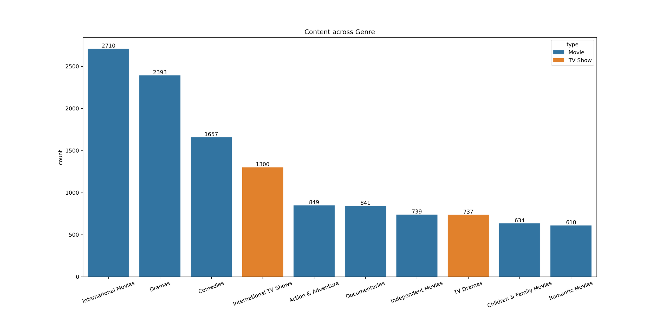
TOP 10 MOST COMMON GENRES.
The bar chart compares the distribution of Movies and TV Shows across various genres
Top 3 Common Genres:
International Movies
Dramas
Comedies

Slide 9
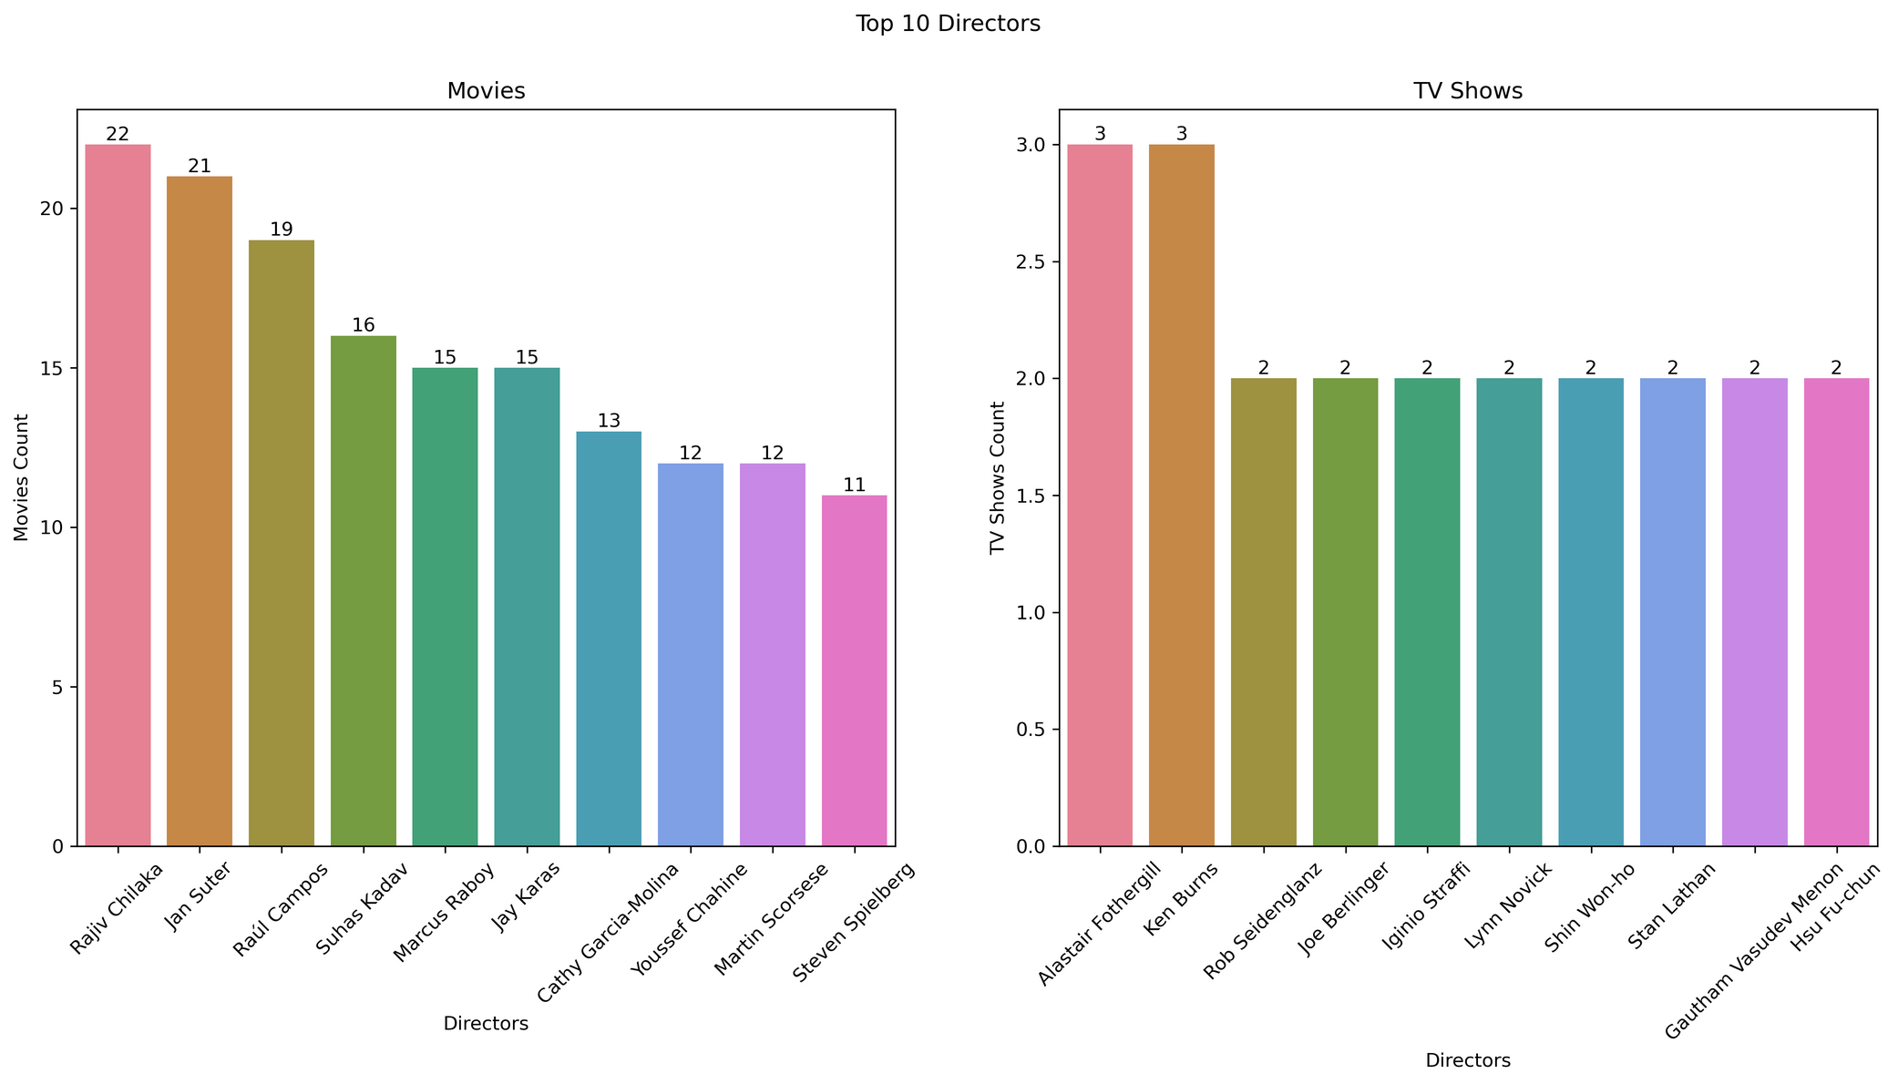
TOP 10 DIRECTORS ON NETFLIX
Top 3 Movies Director:
Rajiv Chilaka With 22 Movies
Jan Suter With 21 Movies
Raul Campos With 19 Movies
Top 3 TV Shows Director:
Alastair Fothergill With 3 TV Shows
Ken Burns With 2 TV Shows
Rob Seidenglanz With 2 TV Shows

Slide 10
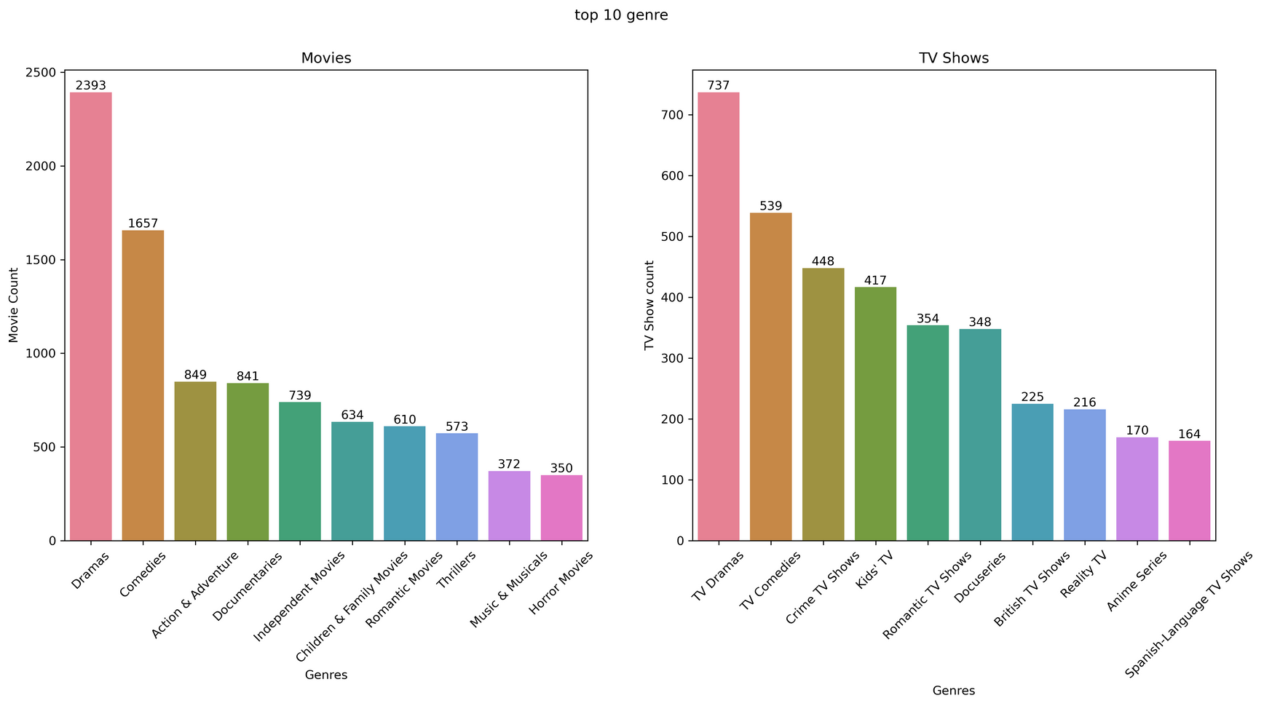
TOP 10 GENRES ON NETFLIX
Top 3 Movies Genres:
Dramas With 2393 Titles
Comedies With 1657 Titles
Action & Adventure With 841 Titles
Top 3 TV Shows Genres:
TV Dramas With 737 Titles
TV Comedies With 539 Titles
Crime Shows with 417 Titles

Slide 11
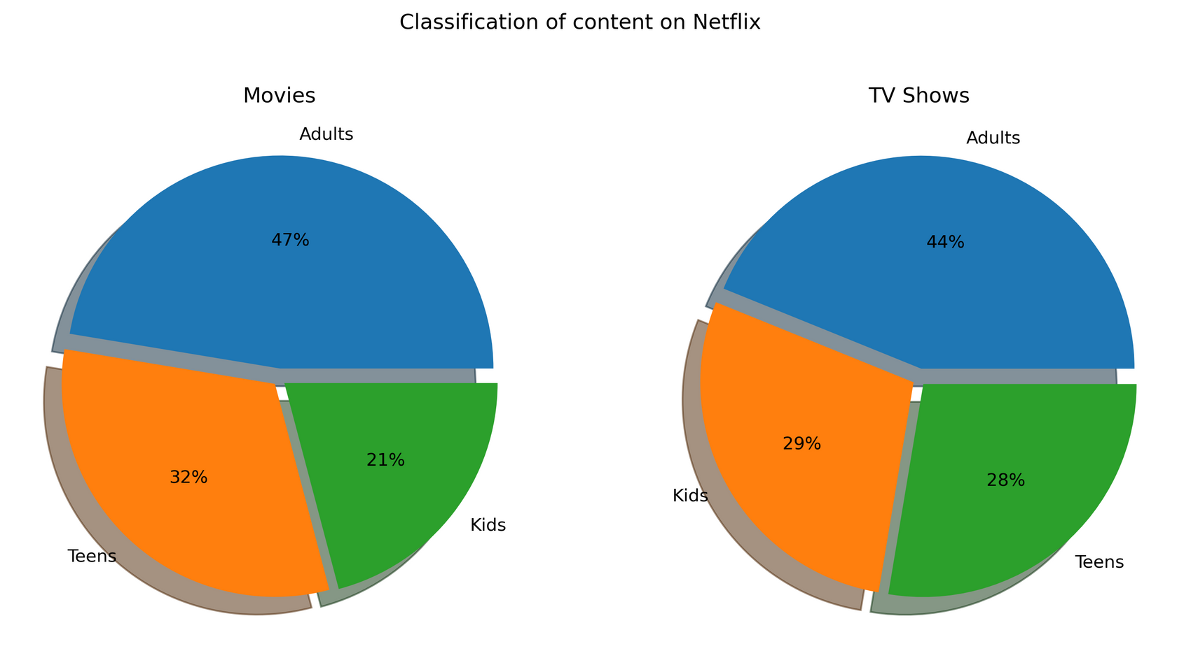
CLASSIFICATION OF CONTENT ON NETFLIX AS AGE WISE
This visualization consists of two pie charts comparing the classification of Movies and TV Shows on Netflix based on the target audience — Adults, Teens, and Kids.
Movies Insights:
47% of movies are targeted toward Adults.
32% cater to Teens, and 21% to Kids.
TV Shows Insights:
44% of shows are meant for Adults,
29% for Kids, and
28% for Teens.

Slide 12
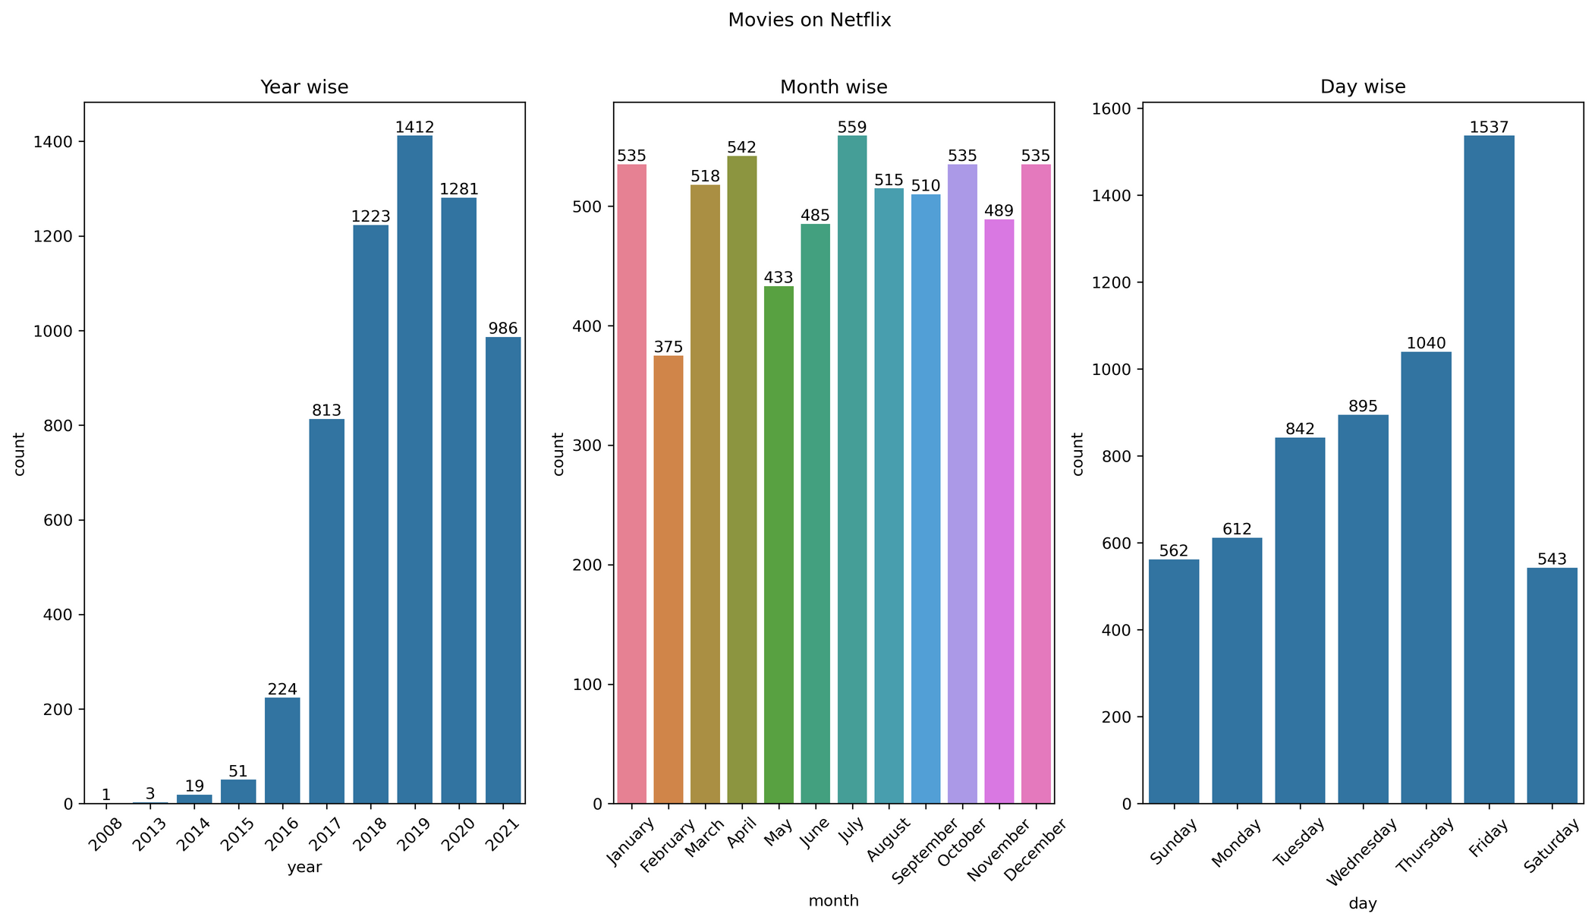
MOVIES ON NETFLIX — YEAR-WISE, MONTH-WISE, AND DAY-WISE TRENDS
Year Wise Insights:
Rapid growth in titles added post-2016.
Peak in 2019 with over 1,412 movies released.
Month Wise Insights:
Most movies are added in July (559).
February has the lowest count
Day Wise Insights:
Friday is the dominant release day with 1,537 movies.
Midweek releases (Tuesday–Thursday) are also frequent

Slide 13
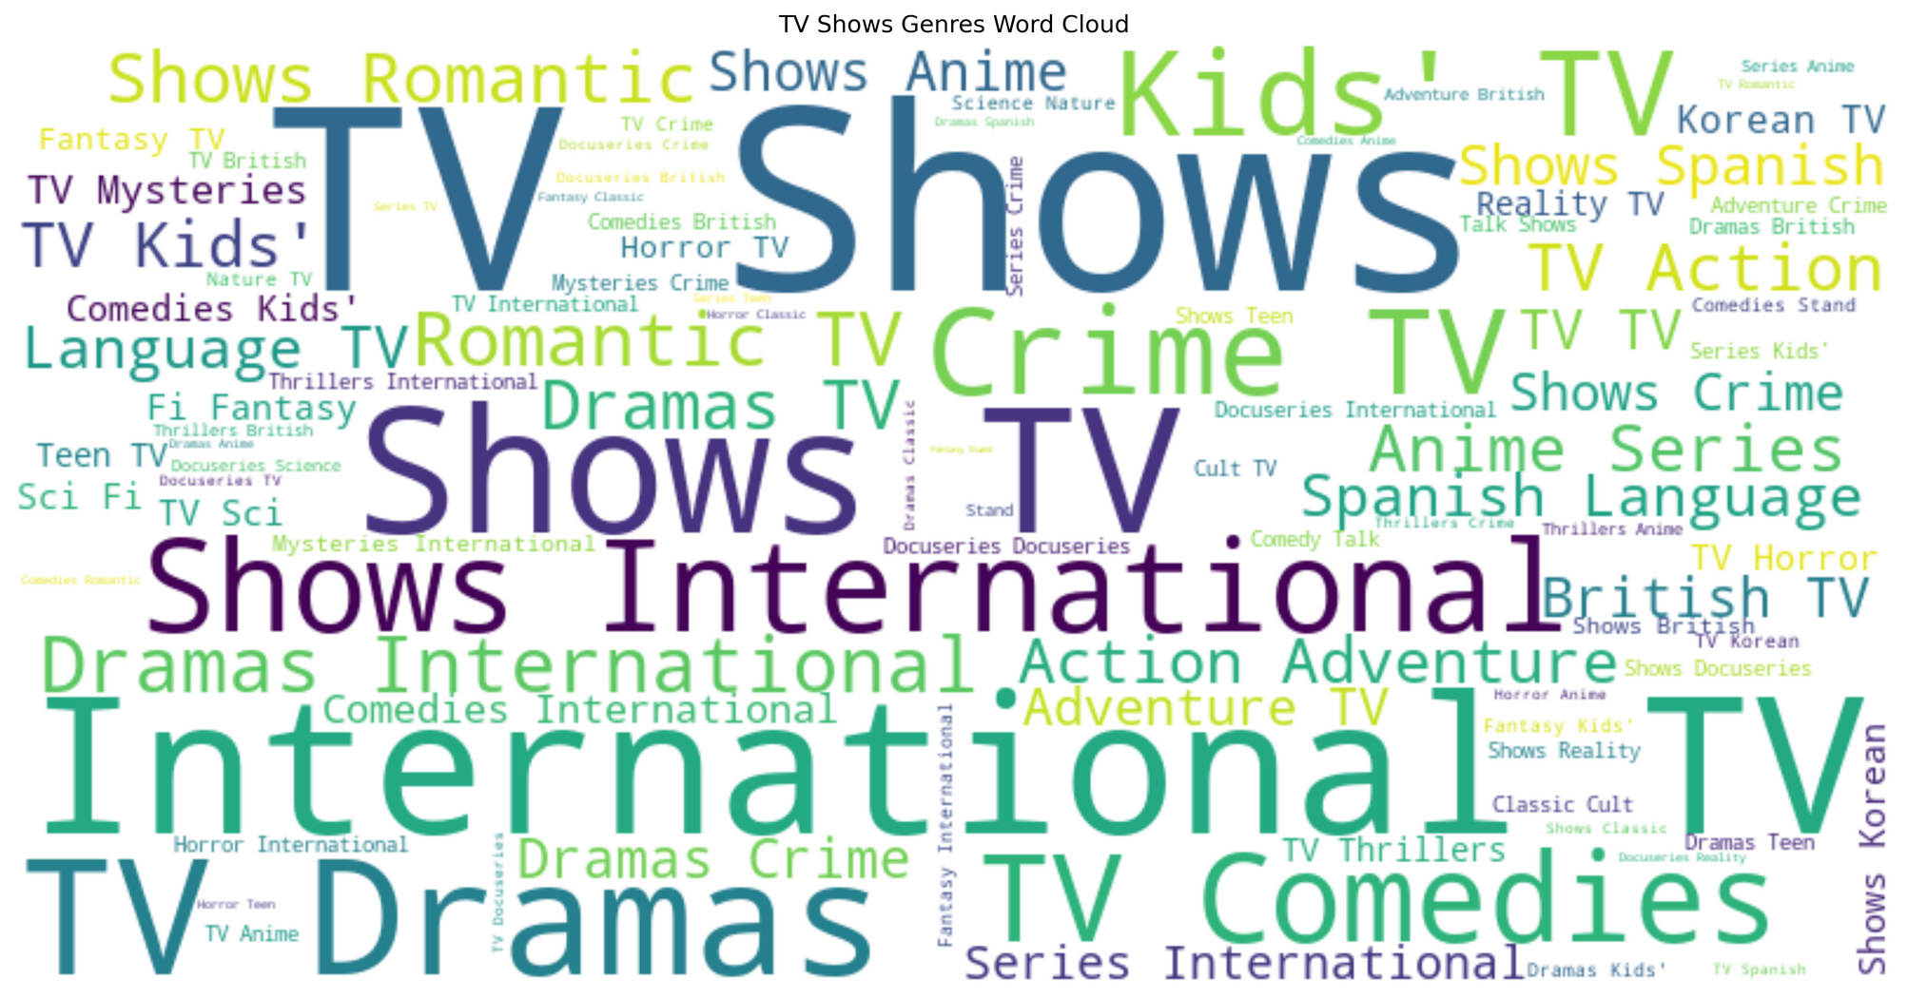
MOST POPULAR TV SHOWS GENRES ON NETFLIX
This word cloud visualizes the frequency of different TV Shows genres on Netflix.
Larger words indicate genres that appear more frequently in the dataset.
Most Dominant Genres:
International TV
TV Shows
Shows International
TV Dramas

Slide 14
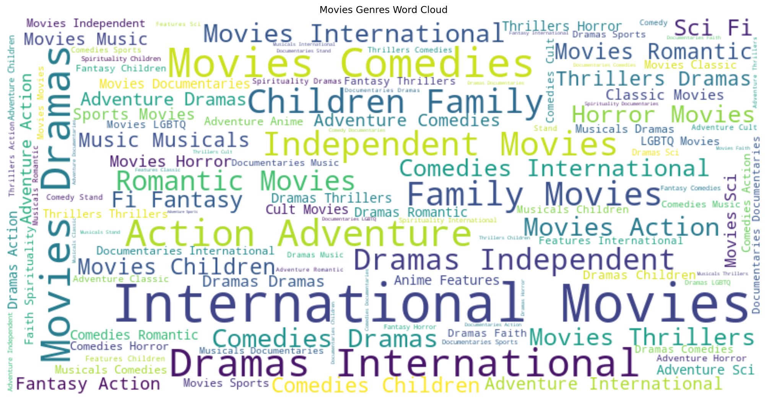
MOST POPULAR MOVIE GENRES ON NETFLIX
This word cloud visualizes the frequency of different movie genres on Netflix.
Larger words indicate genres that appear more frequently in the dataset.
Most Dominant Genres:
International Movies
Dramas
Comedies
Action & Adventure

Slide 15

KEY INSIGHTS OF NETFLIX PROJECT
Majority of Netflix content is Movies.
TV Shows increasing over time.
Netflix focuses on mature audience content.
U.S. and India are leading content contributors.

Slide 16

CONCLUSION
The Future of Data Analysis
Netflix continues to expand with diverse and international content.
Trends reveal strong focus on adult entertainment.
Insights can guide future recommendations and marketing strategies.

Slide 17
THANK YOU!

